Slide 1
Communication VIA Animation of American Sign Language using Kinect

Slide 2
Contents
Aim
ABOUT AMERICAn SIGN LANGUAGE
IMPORTANCE
MS KINECT
PROPOSED PIPELINE
RESULTS

Slide 3
aim
To Create a software that enables communication using SIGN LAnguage
between a normal person and a person who has challenges in hearing and speaking

Slide 4
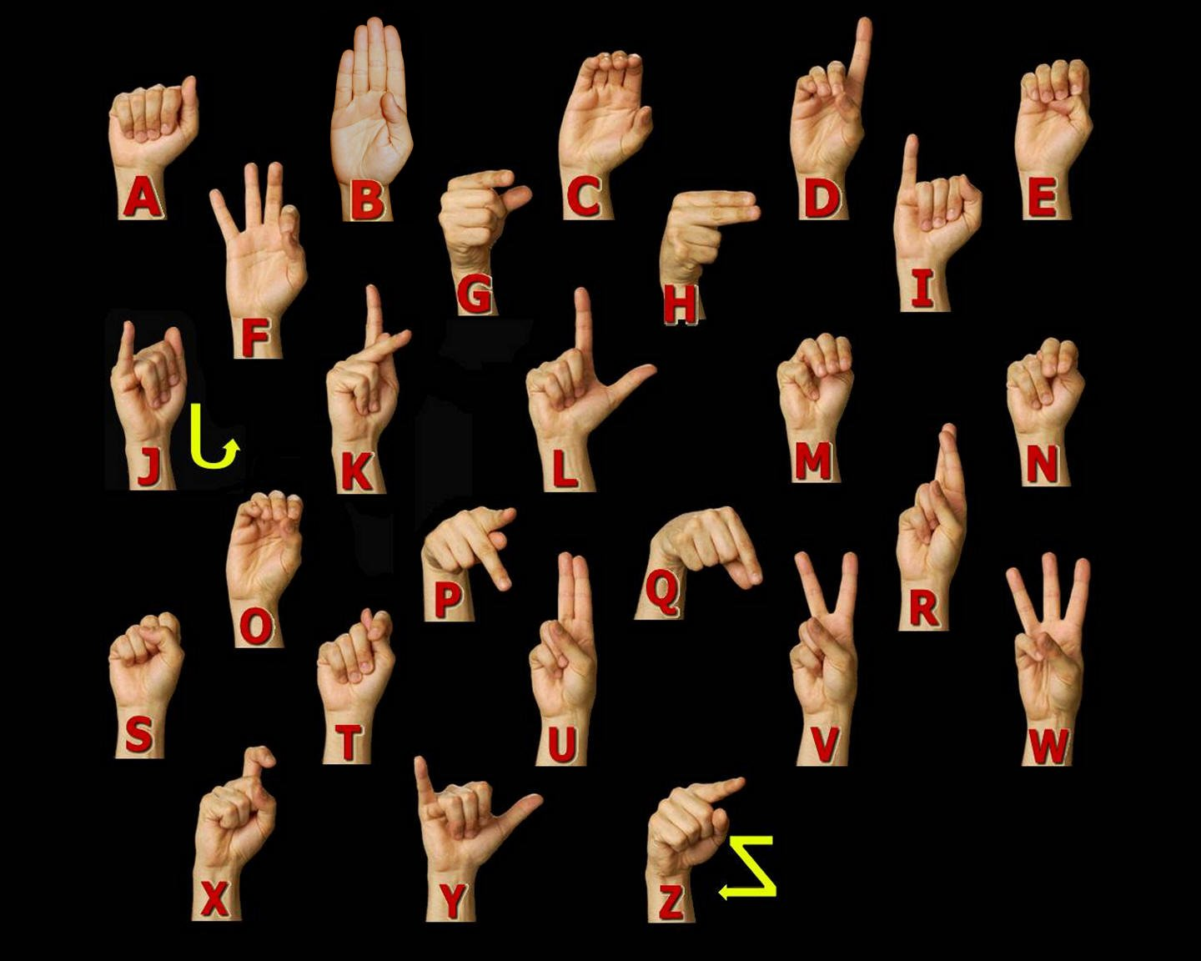
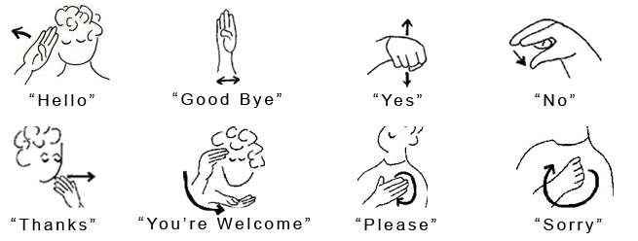
American Sign language
Image source: Internet

Slide 5
importance
survey conducted by Gallaudet University, Washington, DC
1 in 20 Americans are deaf or hard of hearing
High possibility of knowing someone or meeting someone by chance
What happens when they video chat? How to communicate?
Need a system that can translate sign languages for easy communication

Slide 6
Microsoft Kinect to the rescue!
detects body skeleton and visual feed in different forms
can sense motion and record gestures
Thus, Can be used to ease the communication using sign language

Slide 7
pipeline
Record and tag the recorded gestures for classification
Train the classifier using Adaboost algorithm with sufficient training examples for each gesture
Store gestures in the database with appropriate format conversions so as to facilitate the gesture identification process
Display the translated text

Slide 8
pipeline(continued)
Generate a database of animated gestures performed by a human rig using Blender
Getting the text input and finding the suitable response
Displaying the gesture corresponding to the response

Slide 9
UI IDEA
Two UI – one for deaf and one for ordinary person
Deaf to me communication
Detect that DEAF person made a gesture in front of Kinect
display what the gesture means in form of text to me
me to deaf communication
I type the response
Now show the response in the form of an animation to the deaf person

Slide 10
Results

Slide 11
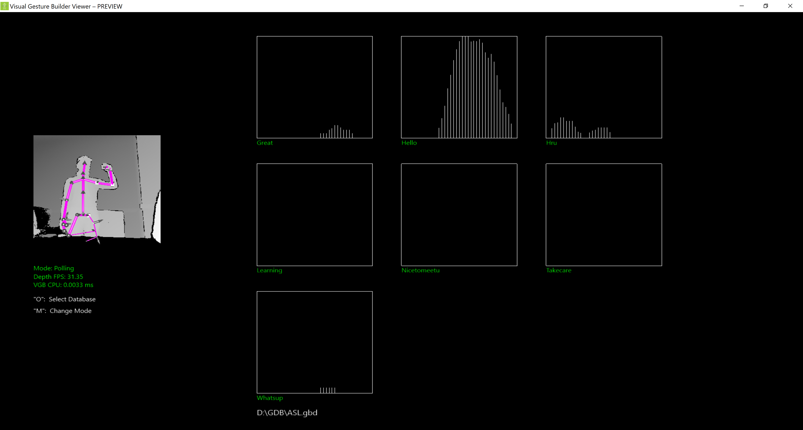
Gesture recognition - HELLO
Hello
great
How are you
I am learning to sign
Nice to meet you
Take care
What’s up?

Slide 12
Response Hello (in ASL)
Blender Character Vincent https://cloud.blender.org/p/characters/5718a967c379cf04929a4247

Slide 13
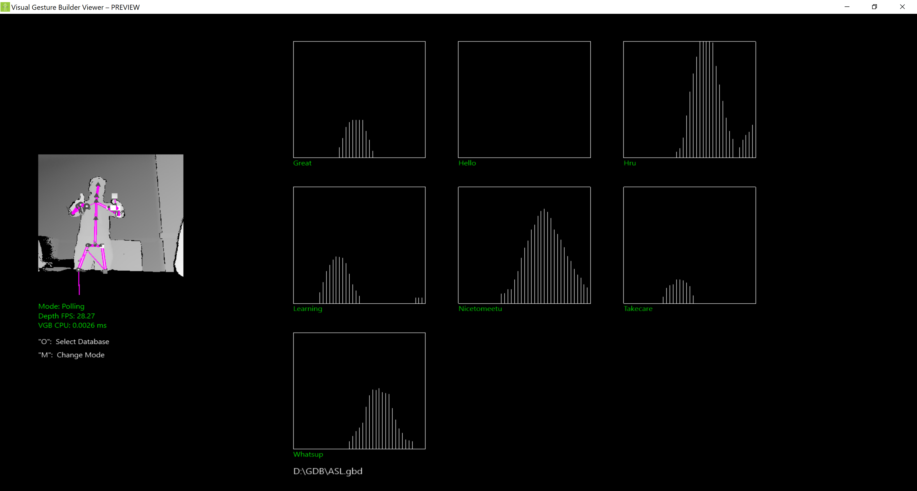
Gesture recognition – How ARE YOU?
How are you?
Nice to meet you

Slide 14
Response Good (in ASL)
Blender Character Vincent https://cloud.blender.org/p/characters/5718a967c379cf04929a4247

Slide 15
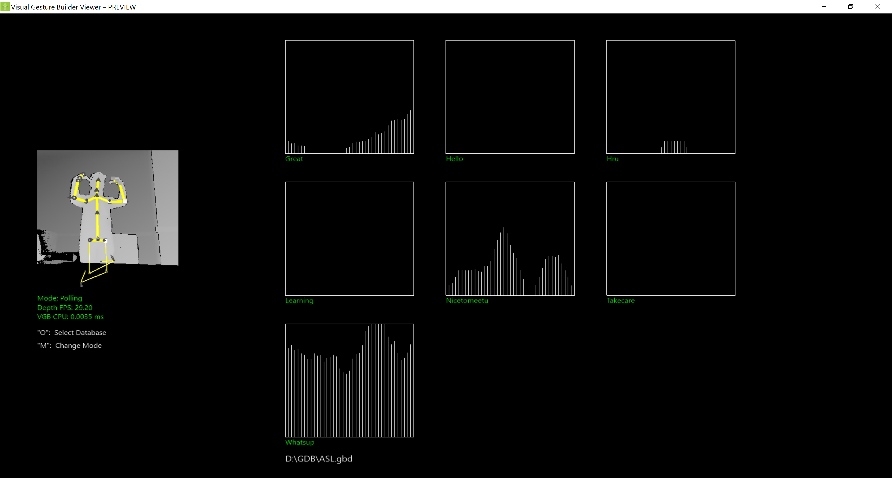
Gesture recognition – What’s up?
What’s up?

Slide 16
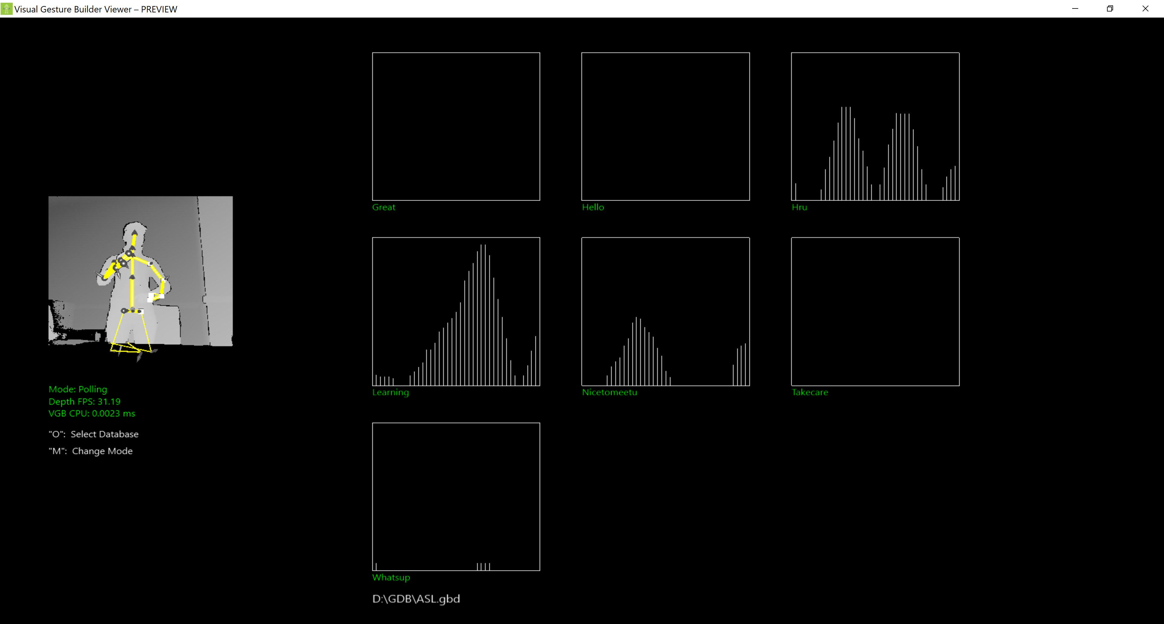
Gesture recognition – I am learning to sign
How are you?
I am learning to sign

Slide 17
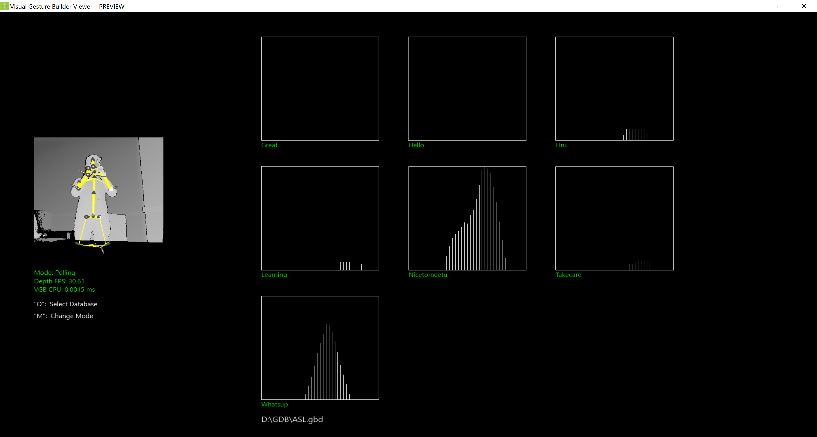
Gesture recognition – nice to meet you!
Nice to meet you!
What’s up?

Slide 18
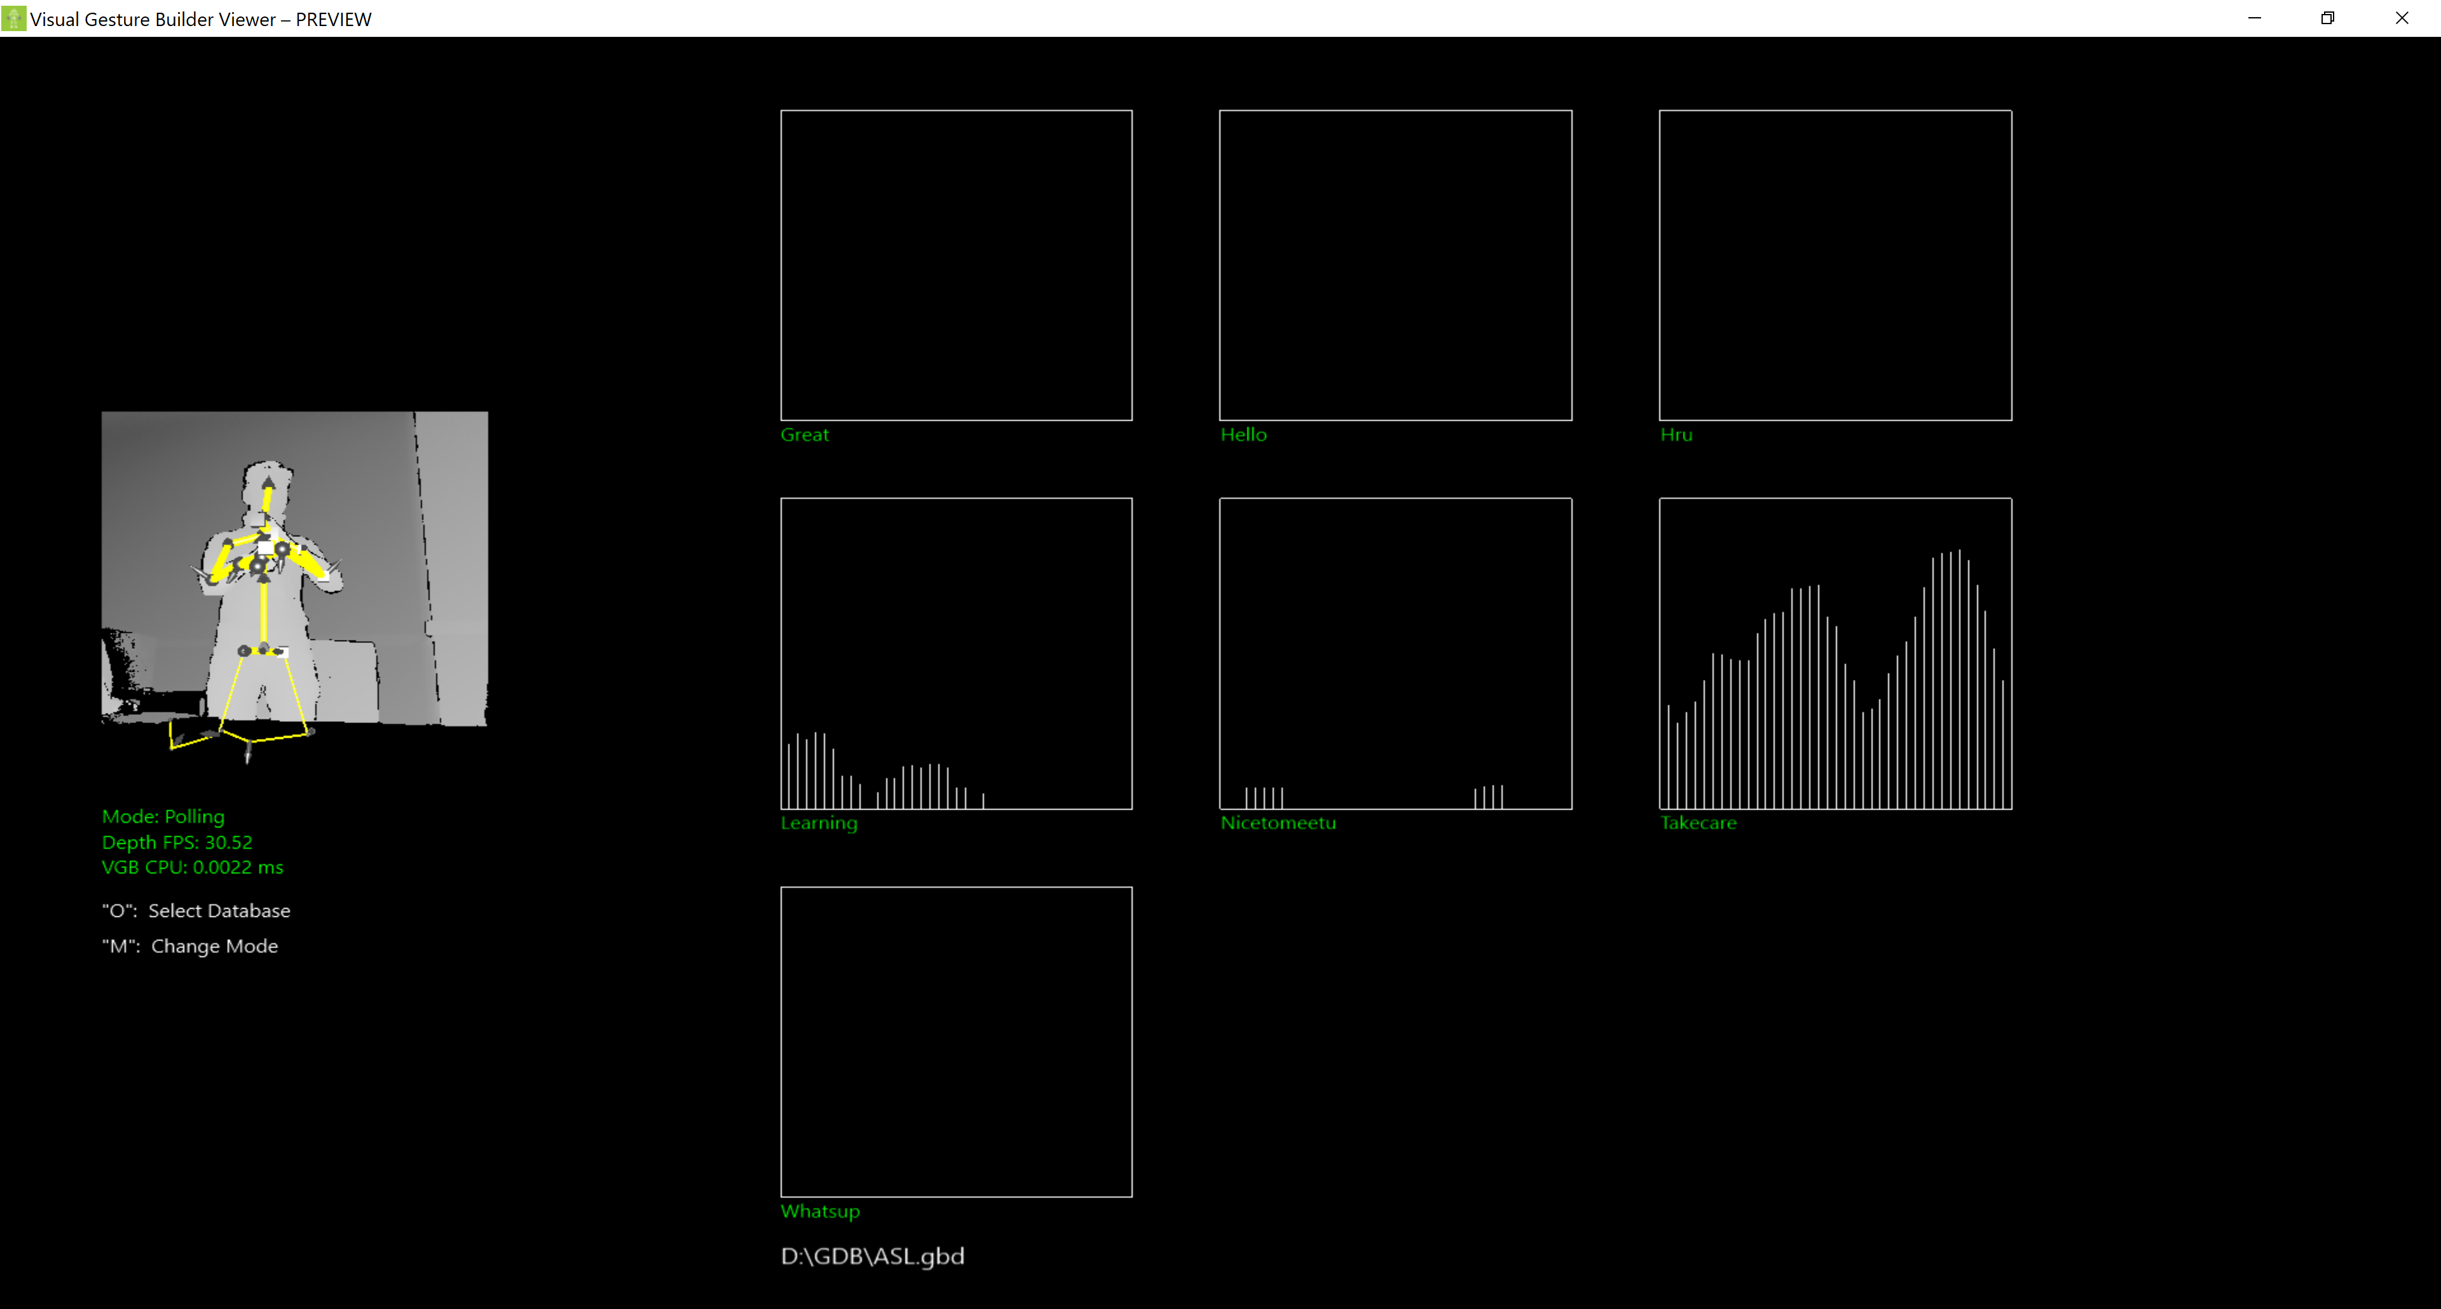
Gesture recognition – take care!
Take care!

Slide 19
DEMO

Slide 20
Questions?

